Slide 1
Stanley X Hackathon
System for identifying, capturing, and organizing critical knowledge
Link
Vijay Balasubramaniam & Nithin Vijaykumar

Slide 2
Ideation Phase

Slide 3
Design Goals
Accessible - Works on any phone, tablet or computer
Simple - Provides an intuitive user experience
Incentive-driven - Provides all users with economic incentives to participate by contributing and curating high quality content
Extensible - Built using open source technologies that have robust community support and a thriving plugin ecosystem
Cost-effective - Uses serverless technologies where possible to minimize operating costs

Slide 4
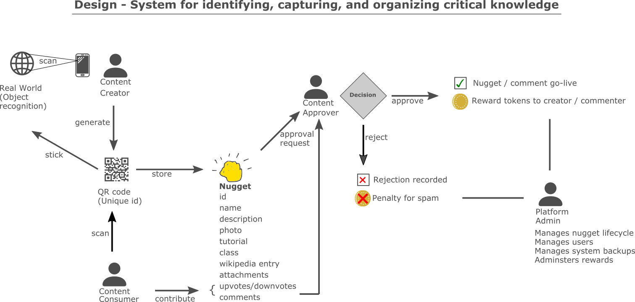

Slide 5
Capabilities
Minimum Viable Product
Core content management using Wordpress including text, video, attachments
Knowledge capture into a “nugget”, and retrieval using directory lookup and search
Physical workspace integration using QR code stuck to machines
User roles for content creator, consumer, approver and admin + approval workflow
Enhancements (roadmap)
Image recognition (AI) using Tensorflow and/or Cloud Vision
Workspace mapping to capture spatial arrangement of equipment
Reward system (gamification) to encourage positive contribution and discourage spam
Learning path tied to job roles across multiple manufacturing/distribution facilities
Credentials automatically unlock access to machines that require safety training

Slide 6
Constraints and Known Issues
Constraints
Since cost effectiveness is a design goal, the system is designed to work on free or inexpensive cloud servers, and use serverless technologies so that costs are incurred only when the system is in use
Since widespread device support is a design goal, the system is built as a web application that works on any phone, tablet or computer
Known Issues
None at this time

Slide 7
Project Building Phase

Slide 8
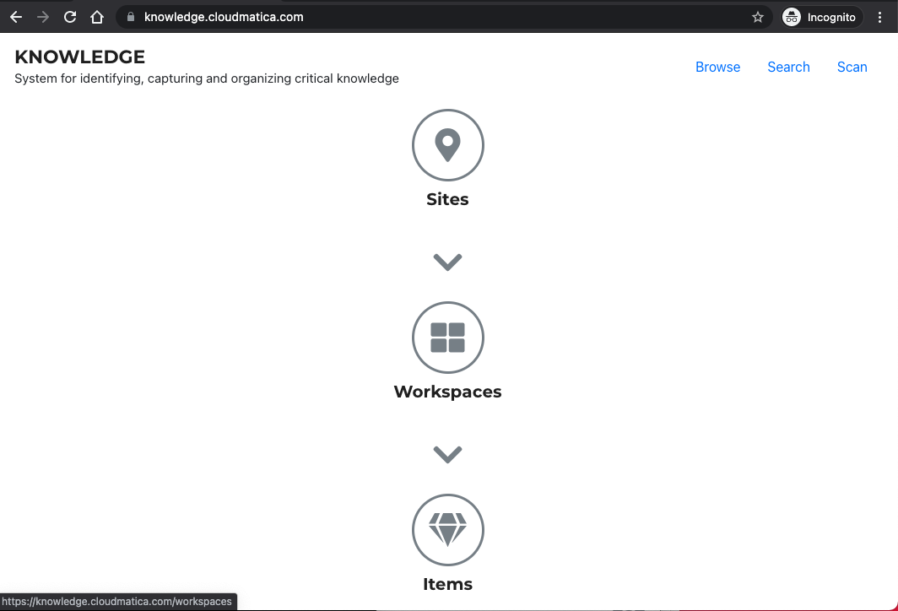

Slide 9
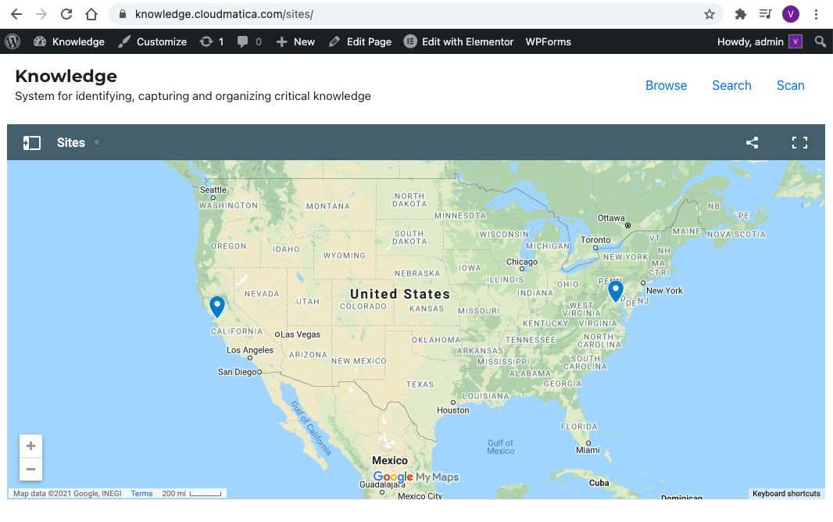

Slide 10
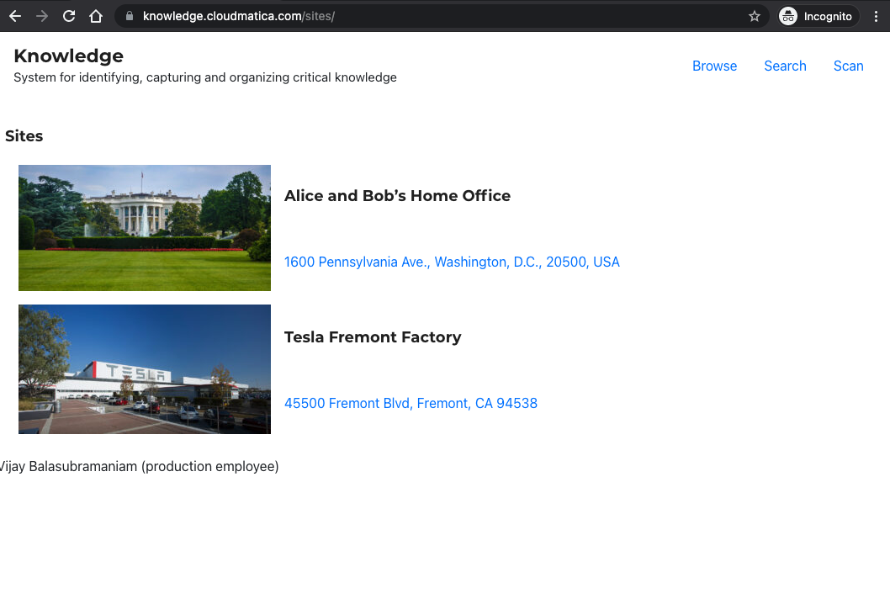

Slide 11
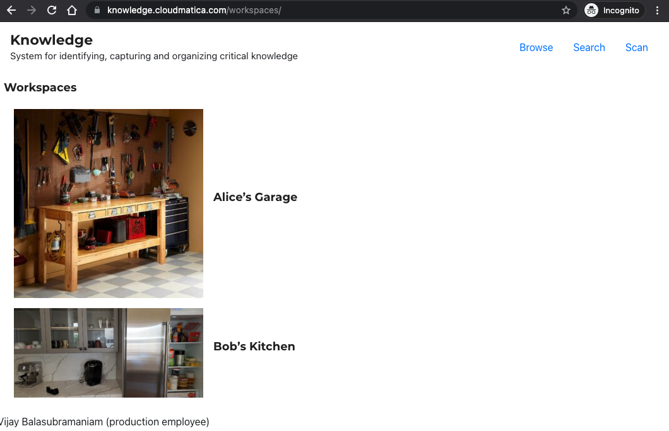

Slide 12
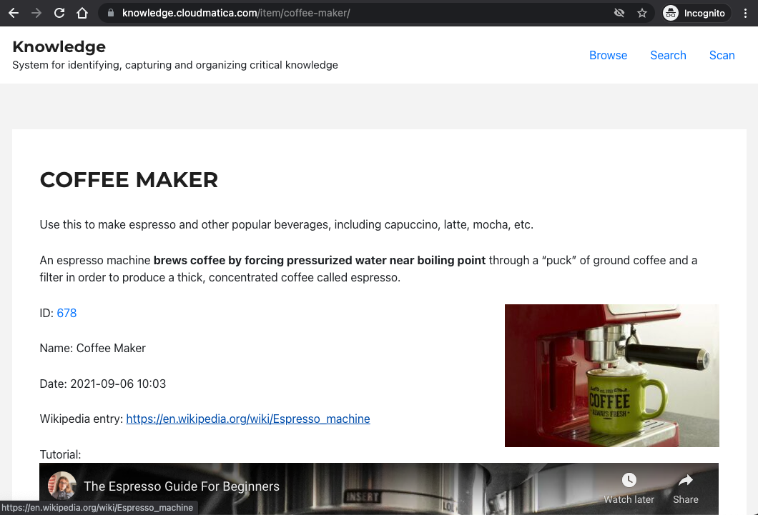

Slide 13
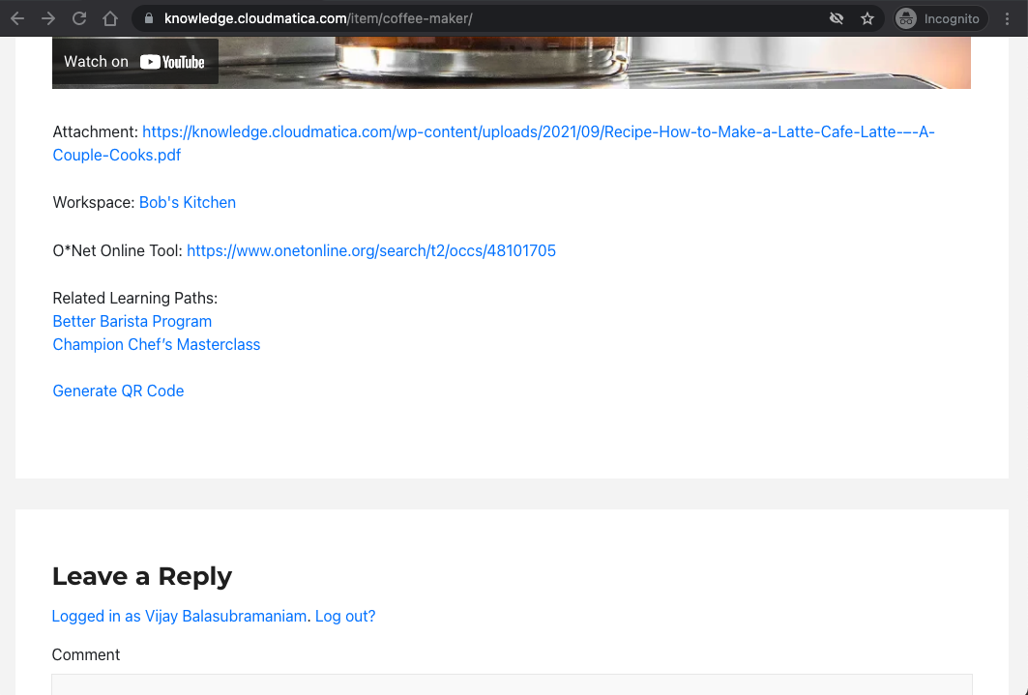

Slide 14
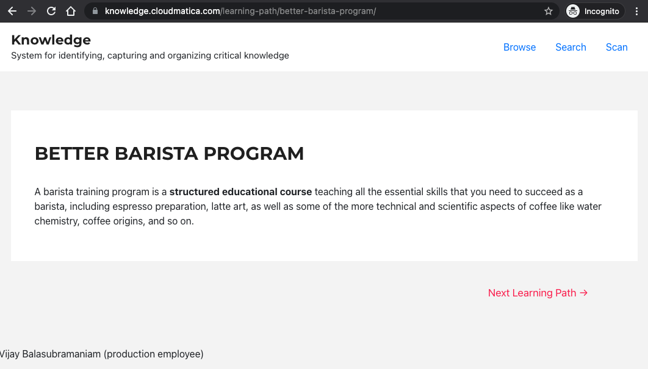

Slide 15
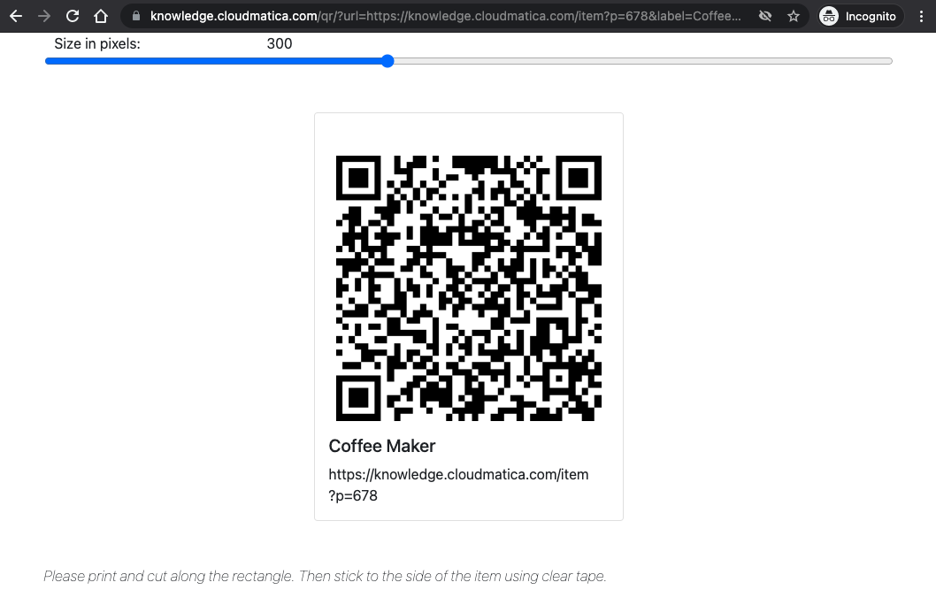

Slide 16
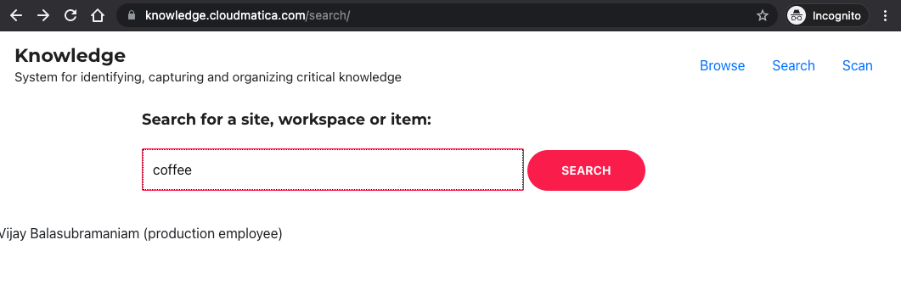

Slide 17
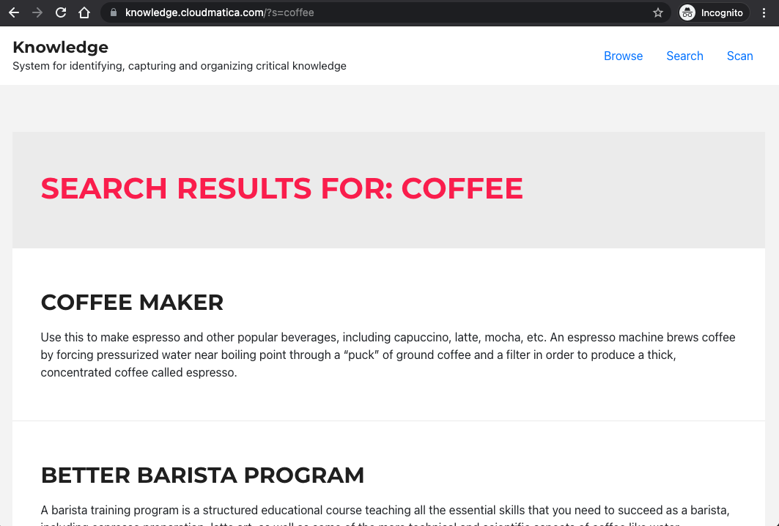

Slide 18
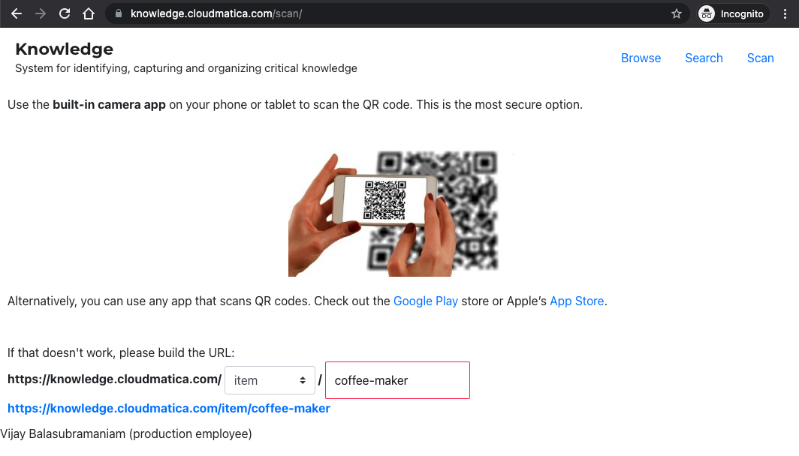

Slide 19
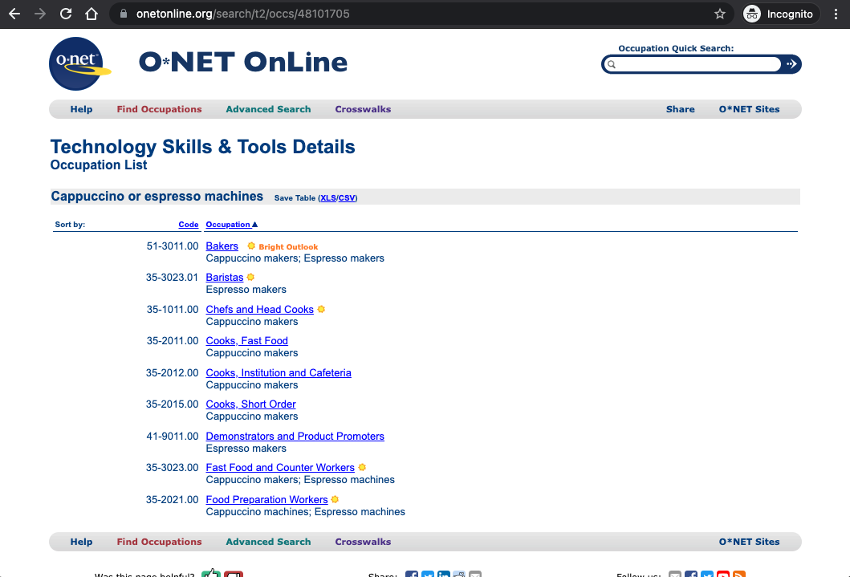

Slide 20
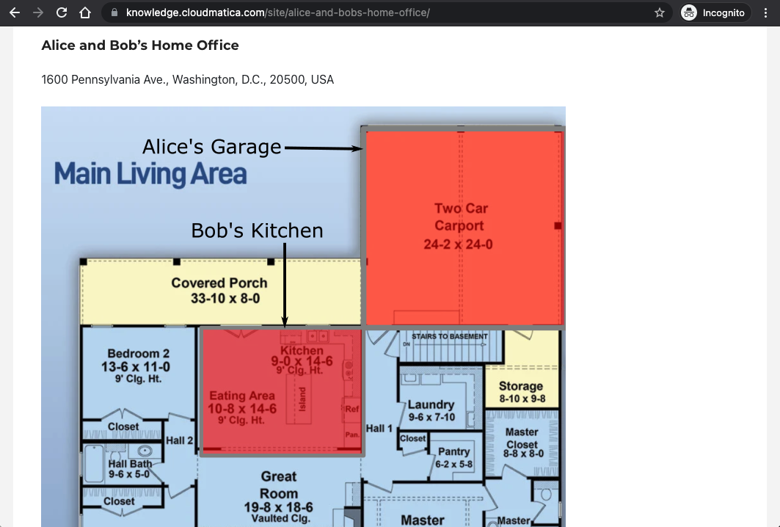

Slide 21
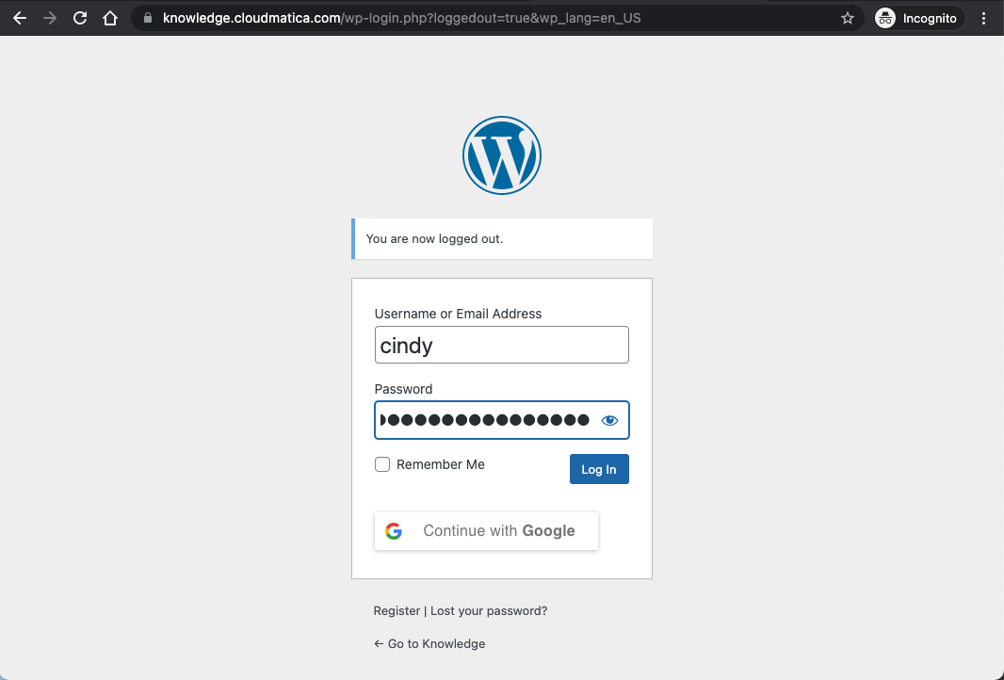

Slide 22
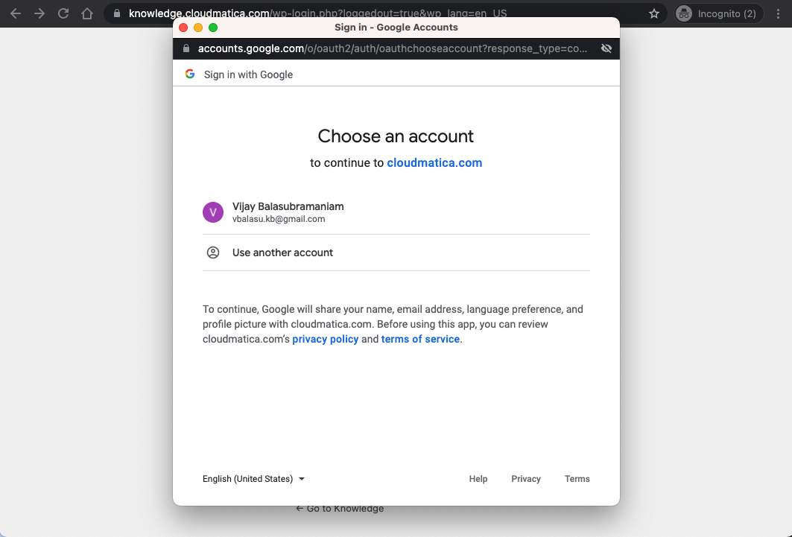

Slide 23
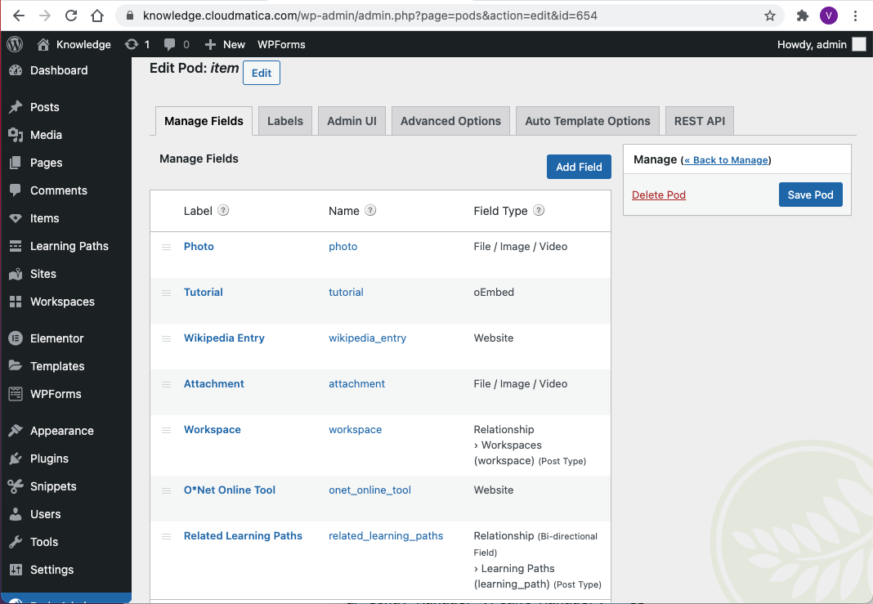

Slide 24
